Slide 1
Web Application security #1
Session hijacking via man in the middle attacks

Slide 2
Why are we here?
Because we use the internet.
Because we make web applications.
Because we are high-end IT professionals.
Because security breaches are big news now.

Slide 3


It’s not my fault
It’s this guy

Slide 4


What is this secret hi-hat middle-man thingy?
A session hijack is where you have a session - an ongoing conversation - with a website, and an attacker gains access to this session, communicating with the site as if he were you.
A man in the middle (MITM) attack is where the attacker can intercept the network communications between your browser and the server, and read, block or modify it.
Say what?! Let’s start again.
How does Sir Clifford Chatterley correspond with his bank manager when he only has Mellors to carry his mail?
Trusted?

Slide 5
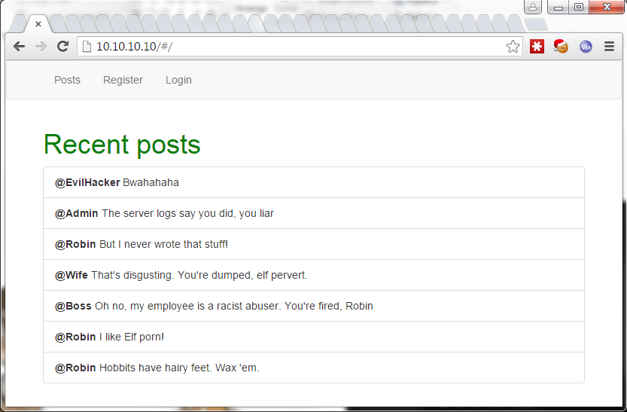

Slide 6
Whoa! Is this shit for real?
It sure is, yes.
Your PC may be compromised.
Your router may be compromised.
Your wireless network may be compromised.
Your ISP may compromised.
All of these bad things happen, repeatedly.

Slide 7
Cool. Would you google that for me please?
LMGTFY:
http://www.theregister.co.uk/2015/11/23/dude_youre_getting_pwned http://www.theregister.co.uk/2003/11/07/help_my_belkin_router http://www.theinquirer.net/inquirer/news/2045528/hundreds-log-rogue-wireless-hotspot-infosec-conference http://news.softpedia.com/news/Tunisian-Gov-Is-Primary-Suspect-in-Mass-Theft-of-Gmail-Yahoo-and-Facebook-Logins-176453.shtml

Slide 8
OM(F)G. What should I do?
Don’t reuse passwords.
Understand what data is sensitive.
Don’t do sensitive stuff on ‘free’ wifi.
Use a modern secure browser.
Check your connections.
Other things too, but here endeth the first lesson…
Any questions?

Slide 9

Or you could go and live in a cave

Slide 10
I’m a developer. Is it all my fault?
Yes it is (mostly) - these problems exist because of weak application security.
We need to understand how to design them out.
We need to know how to review and test for them.
We need to think of our apps as targets, like a hacker does.

Slide 11


Think like a hacker
Study like an Egyptian

Slide 12
What’s this training going to cover?
How the internet works (well, up to a point).
A couple of ways session management is done, and just how broken it can be. <spoiler: very>
How to run a session hijack via MITM.
How to set up tools to test for these vulnerabilities.
What HTTPS gives you, and how.
Some simple fixes / mitigations.
Some less well-known fixes.
Other stuff.

Slide 13

What is HTTPS?
Symmetric encryption of message
Key generated by asymmetric encryption, not exposed in transit
Certificates establish chain of trust

Slide 14
How do I use the training material?
It’s hands on. There are a couple of vulnerable sample apps that run in VMs. Hack them then fix them.
Read the readmes. Read and follow the attack docs (Attacks/*.md).
Developers: Do the exercises. No, really, you may be surprised.
Testers: Do the (testing) exercises. We’ll arrange some extra help.
Everyone: Ask me when you get stuck, point out my errors and gaps. I’m ‘learning by teaching’ here, so please help me learn too ☺.
Everyone: It’s a git repo. Please improve it by sending pull requests (talk to me first, though).

Slide 15

Do the exercises

Slide 16
Yada yada. Are you actually going to show us something now?
Nope.
I’ve blathered on quite long enough.
Go get the repo and do it yourself.
Any questions?
https://github.com/ScottLogic/SecurityTraining/blob/develop/README.md
https://github.com/ScottLogic/SecurityTraining/blob/develop/Attacks/Session%20hijacking%20via%20MITM.md

